Slide 1

Aldo Sebastian Portfolio Projects

Slide 2
Robot Framework Spotify

Slide 3
Spotify
Music streaming service to listen to music without owning them
Need to use their application to access the service
Spotify API: An alternative way to access their service without using their application
Use example:
To add songs to one’s own playlist, one has to do it manually by click and place
What if we have a list of songs? Doing this would take a long time
API allows to add multiple songs

Slide 4
Test Goal
Type of Test Goal | Description | Example of Characteristics
User requirements | Addition of a new playlist and song to the playlist must be possible, given that the user logs in with valid user ID and Token | Functionality, security
Master test plan risk table:
Characteristic: Functionality | Object Parts -> | Total system (total API)
 | Chance of Failure -> | M
Test goals ↓ | Damage ↓
User requirements | M
Characteristic: security | Object Parts -> | Total system (total API)
 | Chance of Failure -> | L
Test goals ↓ | Damage ↓
User requirements | H
Risk Class (A-E) |  | B
Risk Class (A-E) |  | B

Slide 5
Master test plan strategy table
Characteristics/Object | Risk Class (A-E) | DT | ST | UAT
Functionality | B | Not tested for brevity of this presentation | ●● | Not tested for brevity of this presentation
-Total System | B |  | ●●
Security | B |  | ●●
-Total System | B |  | ●●
Test strategy table: only for ST
Characteristics | Object
 | Total System
Functionality | B/●● Functionality
Security | B/●● Security

Slide 6
Test design table
Characteristics | Object | Test type | Test Technique
Functionality | Total System (B/●●) | Functional test | Test unit 1: State Transition Testing
Security | Total System (B/●●) | Usability | Test unit 2: SEM (semantic) test
Test Basis
The Spotify API user manual
OAUTH2 specification book

Slide 7
Test Unit 1: State Transition Testing
State diagram:
start
User supplies user ID
User ID in Spotify database?
No
Yes
Connected to endpoint for user
New playlist contains new song
User supplies Token and requests to create new playlist
User supplies new artist and song to be added
Supplied token corresponds to previously supplied user ID?
No
New playlist created
Yes

Slide 8
Test Unit 1: State Transition Testing
Based on risk class B and test intensity ●●
Test case: all states and transitions
Demo

Slide 9
Test Unit 2: SEM Test
start
Based on risk class B and test intensity ●●
Test the following condition point
Use multiple condition coverage; test all combinations of valid and invalid user ID and user Token
Condition:
IF (User ID is inside Spotify database) AND (User Token corresponds to supplied User ID)
New playlist is created
ELSE
User goes back to start point
Demo
User supplies user ID
User ID in Spotify database?
No
Yes
Connected to endpoint for user
New playlist contains new song
User supplies Token and requests to create new playlist
User supplies new artist and song to be added
Supplied token corresponds to previously supplied user ID?
No
New playlist created
Yes

Slide 10
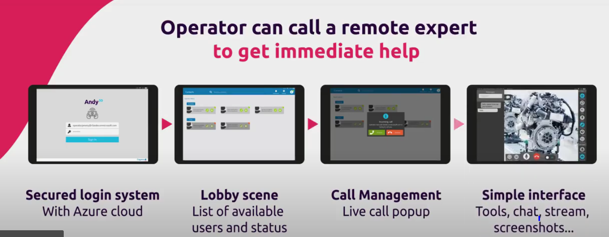
Ambassadorship
Digital manufacturing: Bringing the IT world to improve traditional manufacturing, example use case:
Augmented reality models of machines in factories
Being an ambassador means:
Noticing and recommending such opportunities as above
Promoting practices within the IT world to lifecycle and maintenance of OT software
Notes:
Digital Manufacturing – Capgemini Worldwide

Slide 11
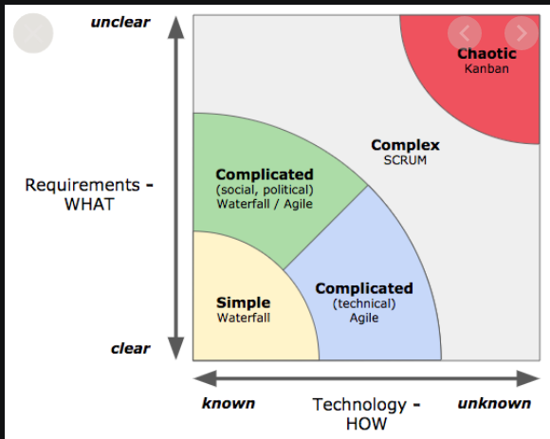
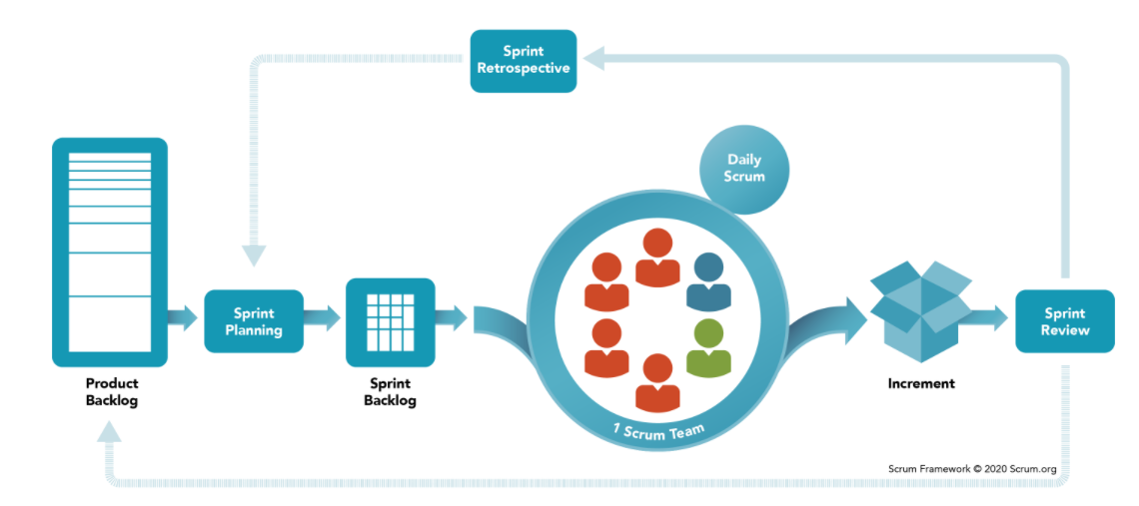
Agile Scrum
Project management tool for certain types of projects
Roles and process is as follows:
Advantages:
Available continuous (improving) working product
Continuous engagement with customer
Daily meetings to measure individual productivity

Slide 12
Git Portfolio
Project management tool for certain types of projects
Roles and process is as follows:
Advantages:
Available continuous (improving) working product
Continuous engagement with customer
Daily meetings to measure individual productivity

